Slide 1



Efficient Algorithms and Plugins for Spatial Analysis in Geographic Information Systems
(Edison) Tsz Nam Chan¹, Tianhong Zhao², Wei Tu¹,
Dingming Wu¹, Leong Hou U³
¹Shenzhen University ²Shenzhen Technology University ³University of Macau

Slide 2









Contemporary GIS Software Packages

Slide 3
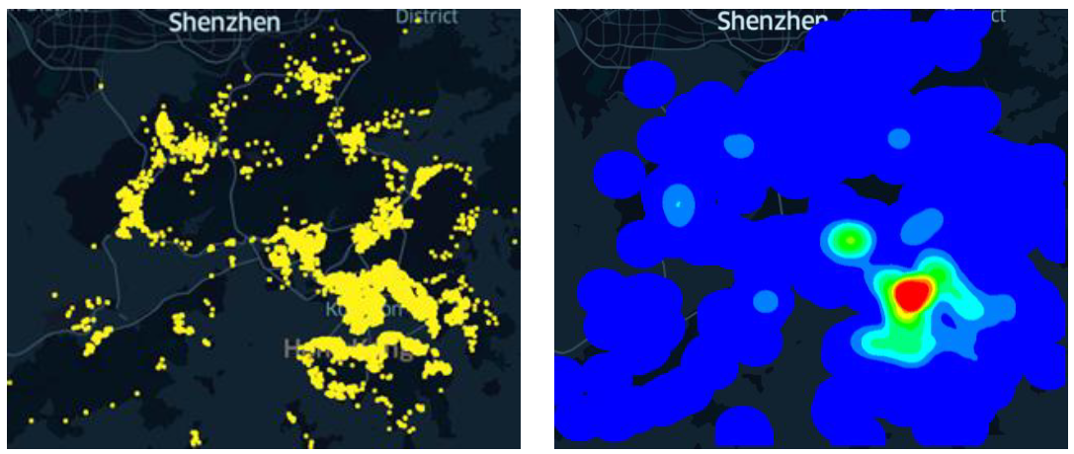
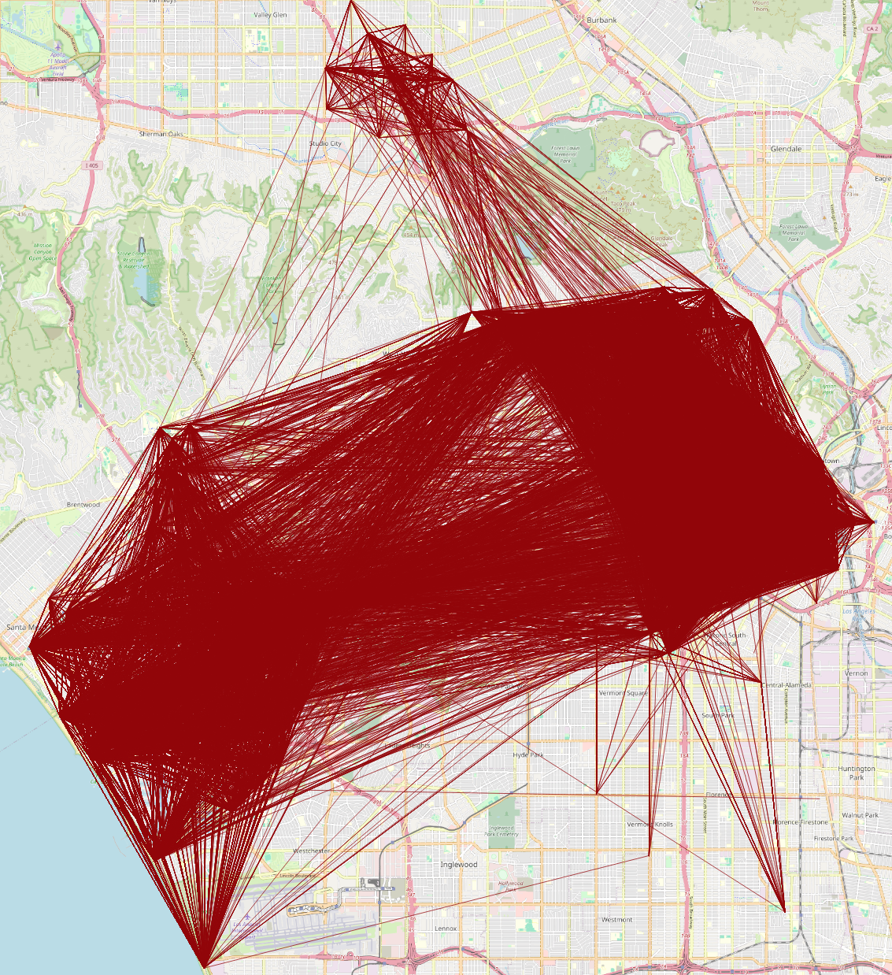
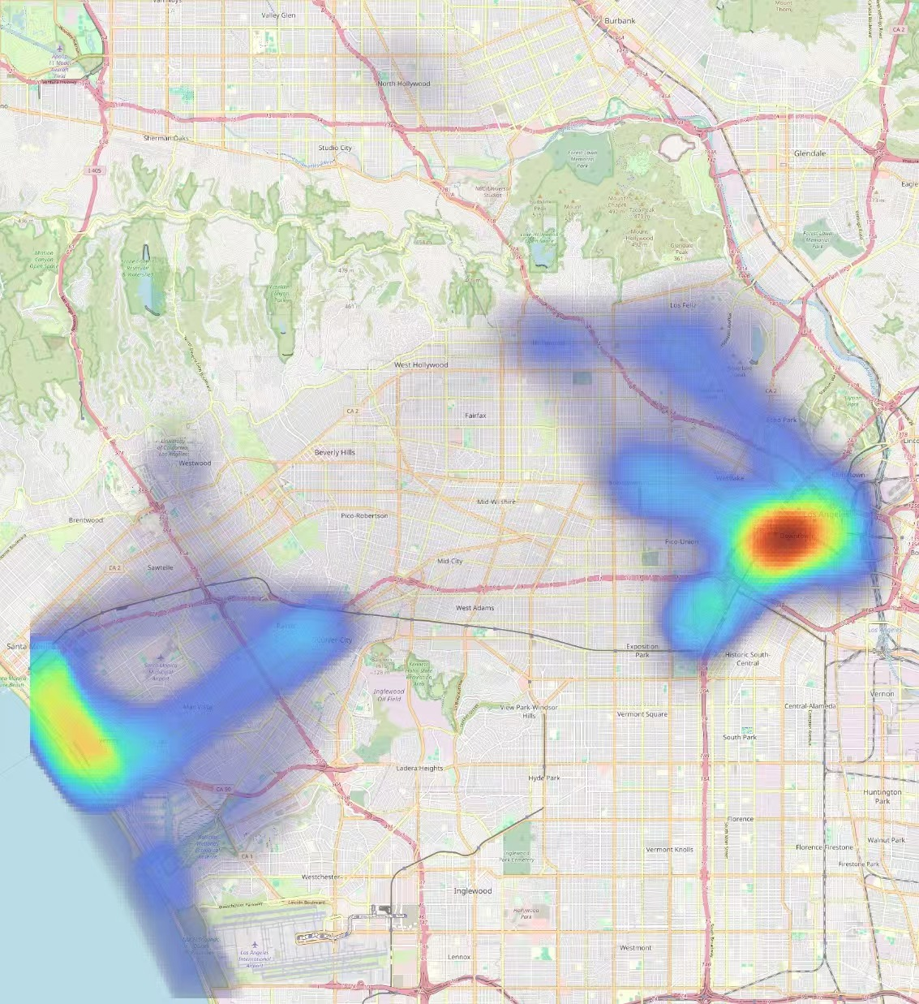
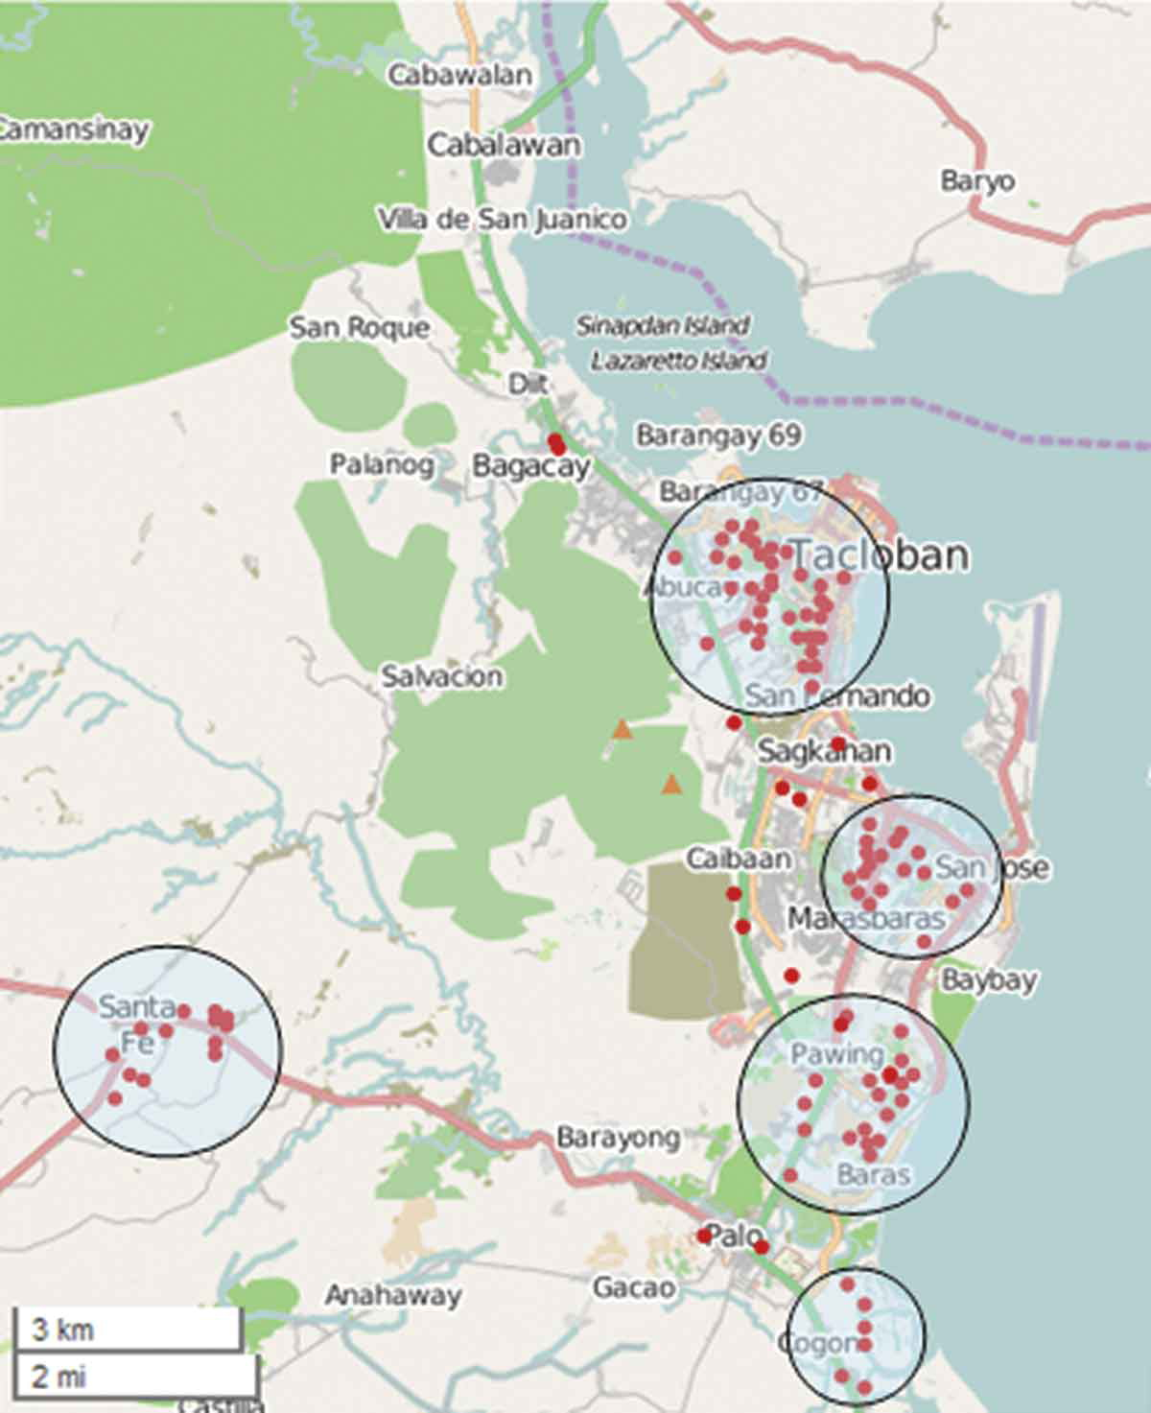
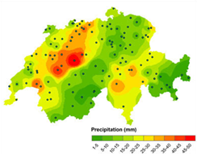
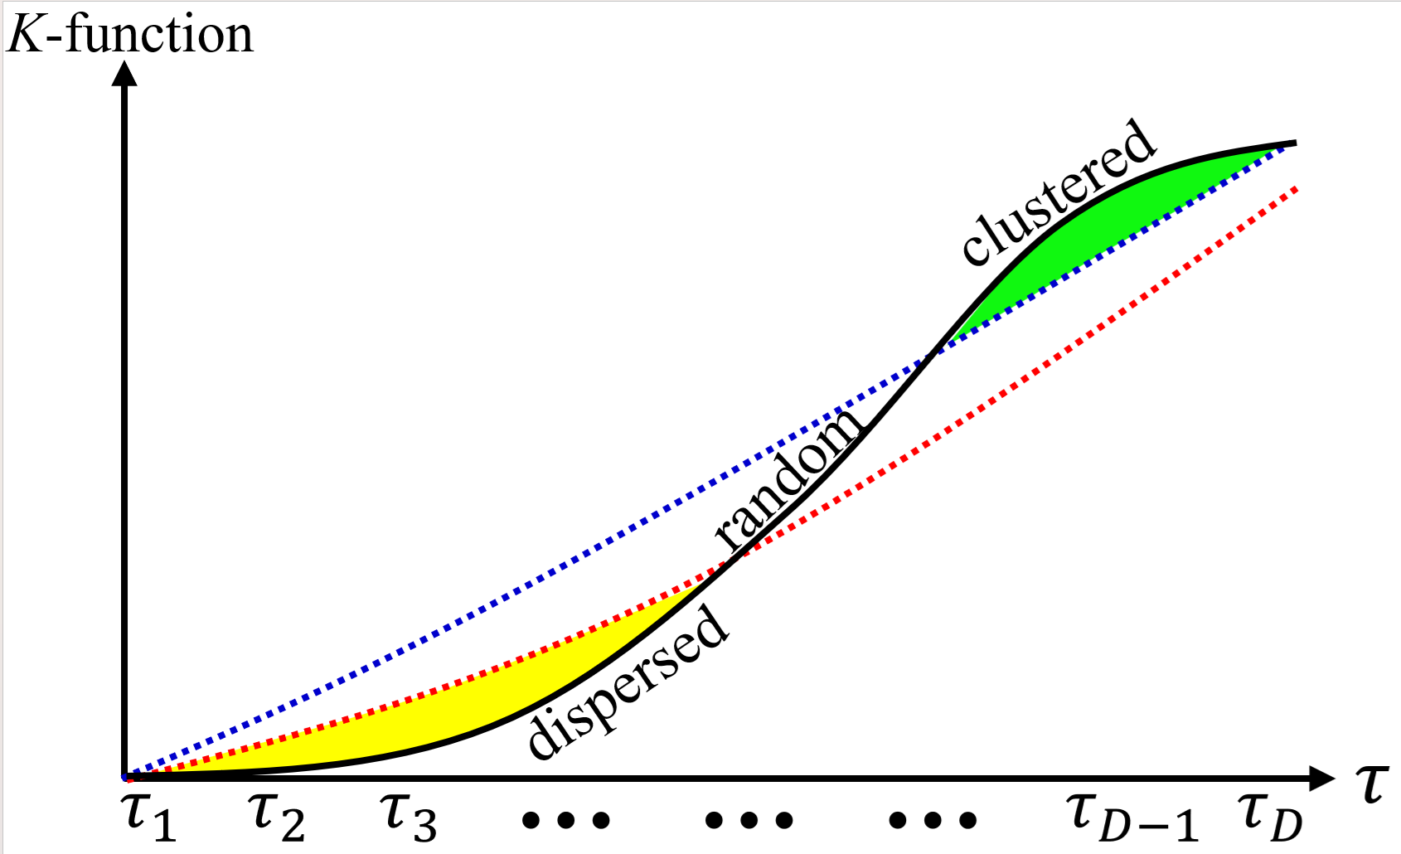
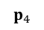
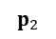
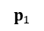
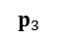
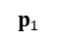
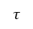
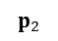
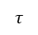
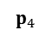
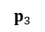
Which Spatial Analysis Tools Can GIS Support?
Point density visualization
Line/flow density visualization
$$p_{3}$$
$$τ$$
$$τ$$
$$τ$$
$$τ$$
$$p_{2}$$
$$p_{3}$$
$$p_{2}$$
$$p_{4}$$
$$p_{1}$$
$$p_{4}$$
$$p_{1}$$
$$τ$$
$$τ$$
$$τ$$
$$τ$$
Dispersed
Clustered
Spatial interpolation
K-function-based Analysis
Point clustering

Slide 4
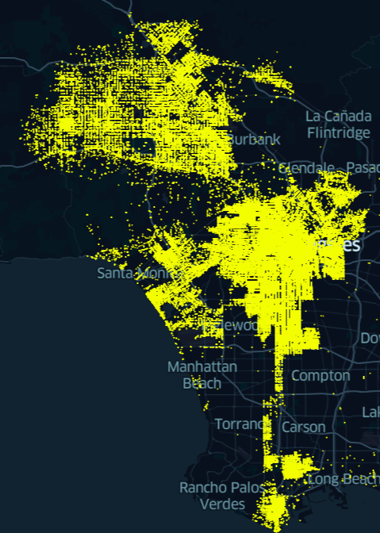
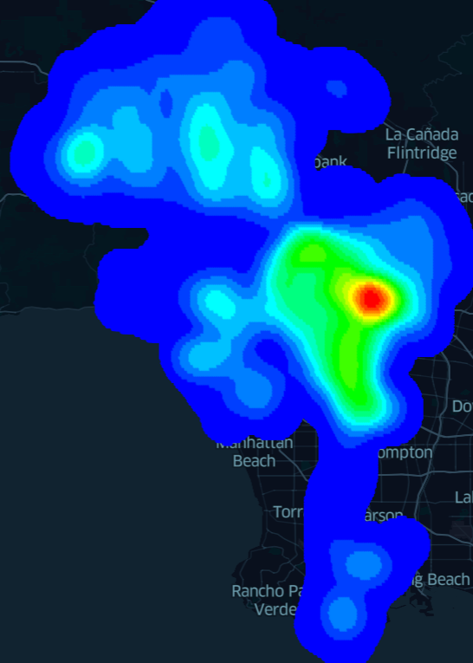
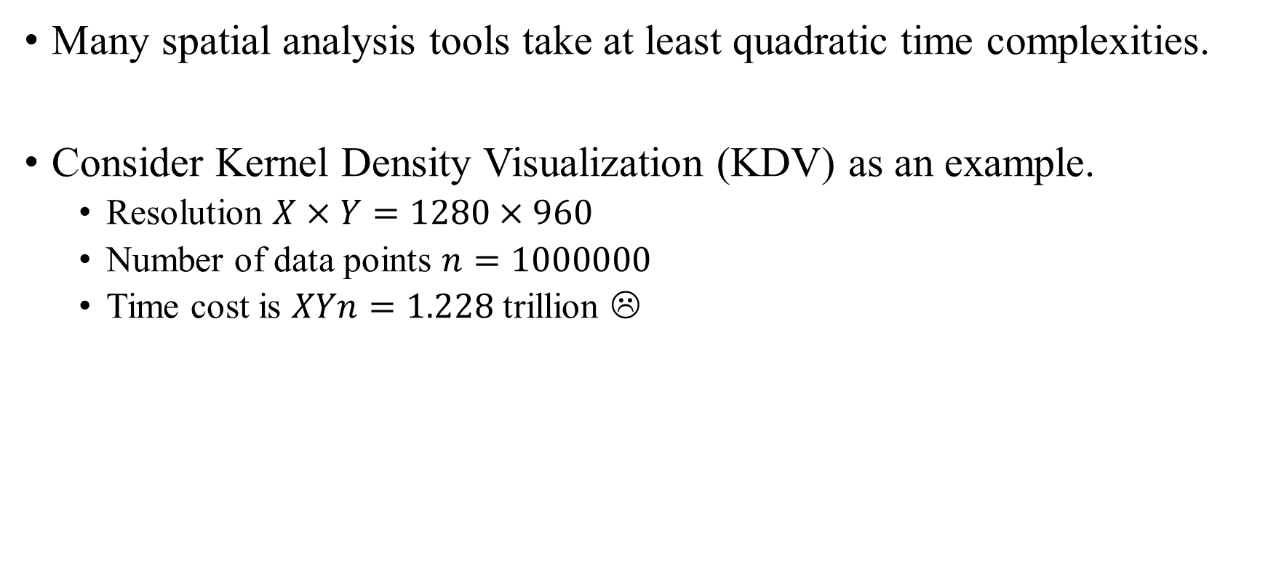
GIS Software Packages are Slow!
Many spatial analysis tools take at least quadratic time complexities.
Consider Kernel Density Visualization (KDV) as an example.
Resolution $X×Y=1280×960$
Number of data points $n=1000000$
Time cost is $XYn=1.228$ trillion ☹
Crime events in Los Angeles
KDV

Slide 5
Why are GIS Software Packages Slow?
Many large-scale location datasets are available.
Lack of research studies for reducing the time complexity of spatial analysis tools.
Many research studies only focus on parallel/distributed settings.
Users may not have too many computational resources.
Users may not have the right to access many computational resources.
Users only use some contemporary GIS software packages, e.g., ArcGIS and QGIS.

Slide 6
Our Preliminary Studies
Successfully reduce the time complexities for different spatial analysis tools.
Kernel density visualization and its variants
K-function analysis and its variants
Line density visualization
Can improve the efficiency for these tools with more than 10x to 2000x speedups under a single CPU setting.

Slide 7
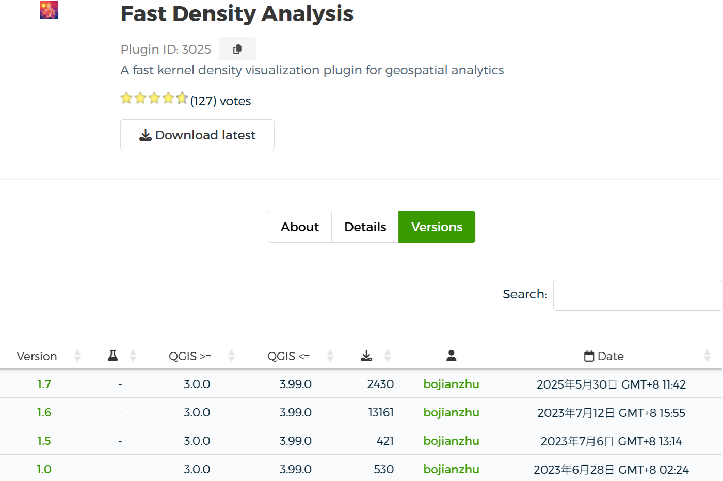
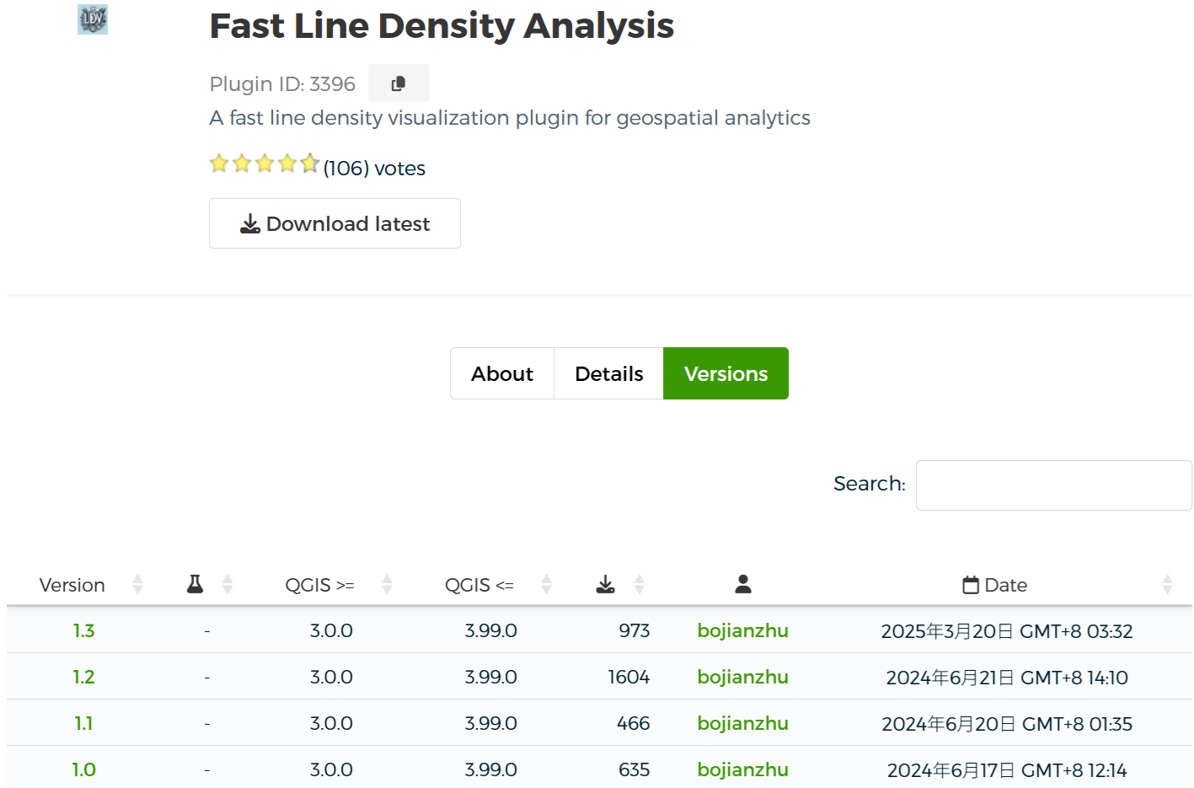
Our Preliminary Studies
Develop two QGIS plugins (based on our efficient algorithms)
16,542
3,678

Slide 8
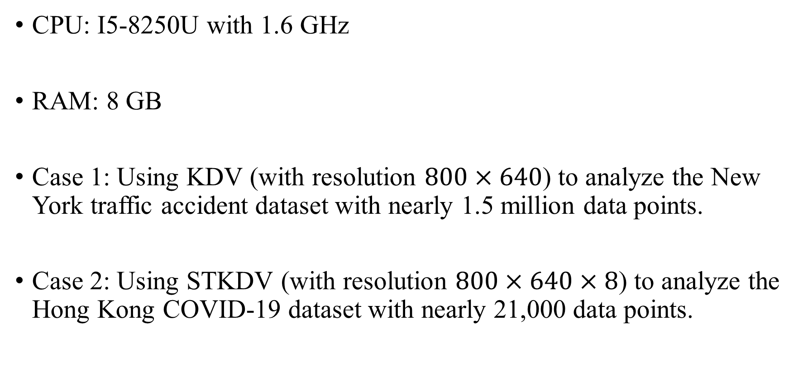
Our Demo
CPU: I5-8250U with 1.6 GHz
RAM: 8 GB
Case 1: Using KDV (with resolution $800×640$) to analyze the New York traffic accident dataset with nearly 1.5 million data points.
Case 2: Using STKDV (with resolution $800×640×8$) to analyze the Hong Kong COVID-19 dataset with nearly 21,000 data points.

Slide 9
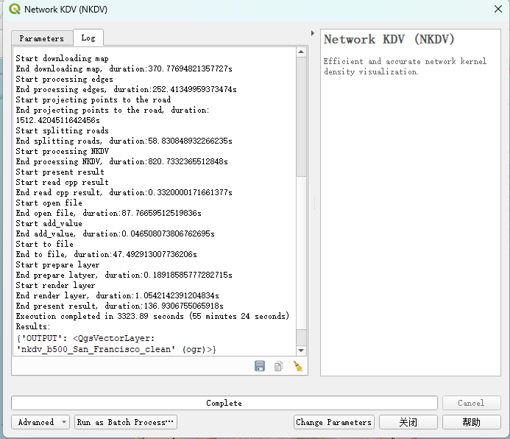
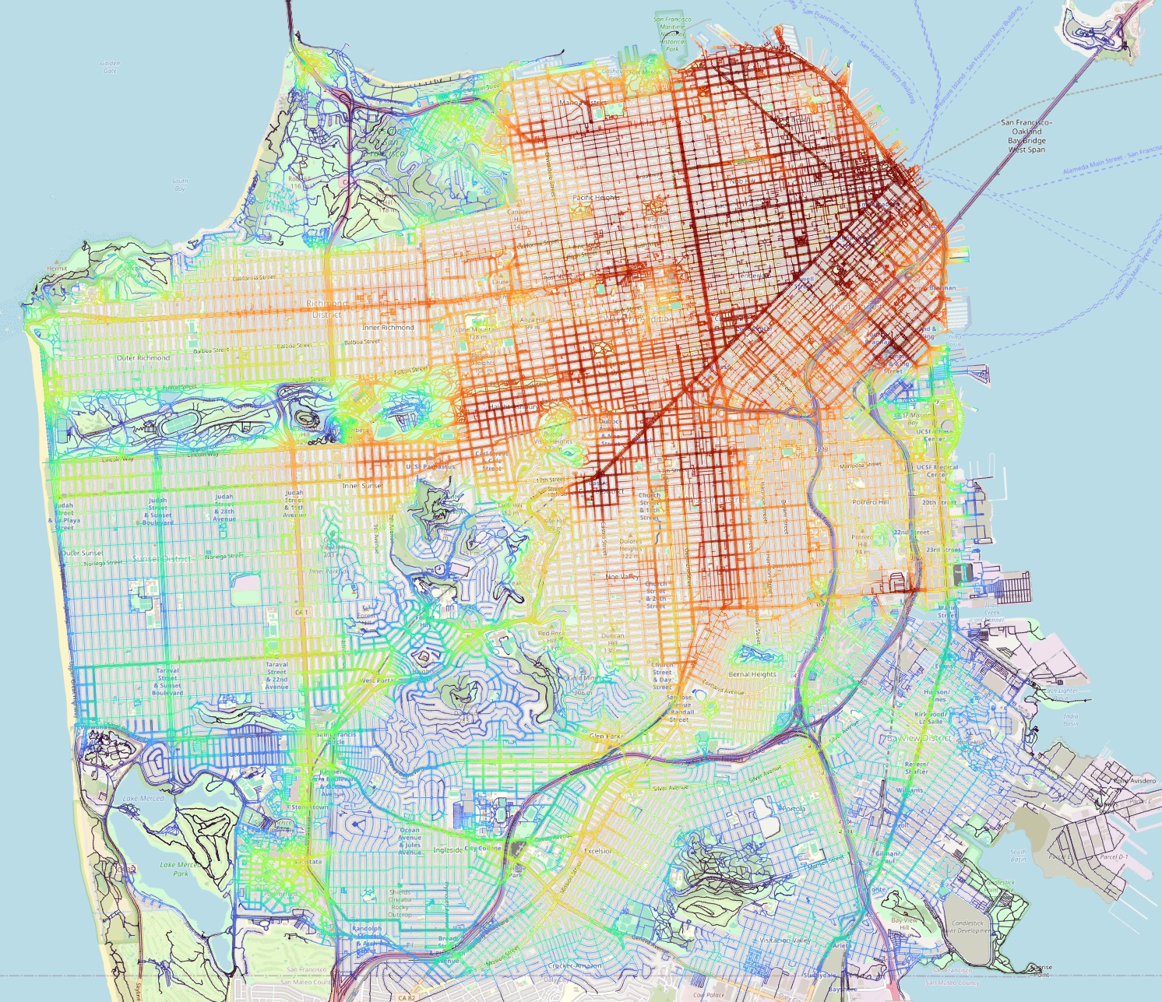
Other Results
Case 3: Using NKDV to analyze the San Francisco 311-call location dataset (with more than 5.962 million data points).

Slide 10
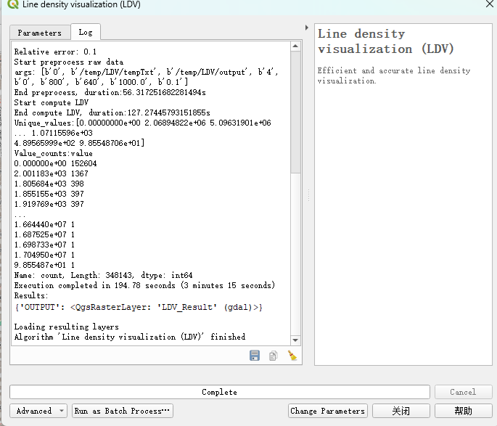
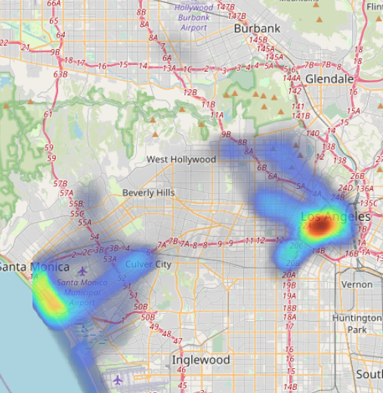
Other Results
Case 4: Using LDV to analyze the Los Angeles bike trajectory dataset (with more than 402 thousands data points).

Slide 11
Future Directions
Develop complexity-reduced solutions to support other spatial analysis tools.
Inverse distance weighting (IDW)
Kriging
DBSCAN clustering
Moran’s I
Getis-Ord General G
Replace those inefficient (obsolete) algorithms in the GIS software packages by efficient algorithms.

